Slide 1
Cyber Security
CSE 301
10/10/2012
By: Samantha Juntiff, Khalid Ibrahim, David Kahn, Colin Hofman, David Humphries, Nina Larkova

Slide 2
Integrated Systems & Cyberspace
Samantha Juntiff

Slide 3
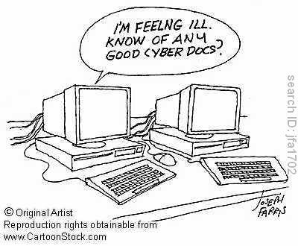
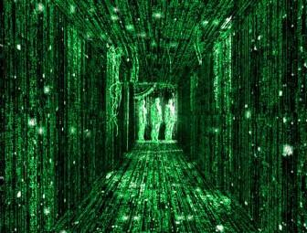
What is Cyberspace?
Cyberspace is the information technology infrastructure that makes up the global domain of the information environment.
http://www.aerospace.org/

Slide 4
"Cybersecurity threats represent one of the most serious national security, public safety, and economic challenges we face as a nation.”
- 2010 National Security Strategy
From 2000 to 2010, global Internet usage increased from 360 million to over 2 billion people.
Has become an incubator for new forms of entrepreneurship, advances in technology, the spread of free speech, and new social networks that drive our economy and reflect our principles.
The security and effective operation of U.S. critical infrastructure – including energy, banking and finance, transportation, communication, and the Defense Industrial Base – rely on cyberspace

Slide 5
Both Sides Hold the Advantage
Hackers are at times successful in entering DoD's networks
DoD is able to obtain public interests alongside private sector interests
DoD has knowledge of cyberspace.

Slide 6

System Integration
System Integration is the bringing together of the components subsystems into one system and ensuring that the subsystems function together as a system.
http://en.wikipedia.org/wiki/System_integration

Slide 7
Methods of Integration
Vertical Integration: is the process of integrating subsystems according to their functionality by creating functional entities also referred to as silos.
Star Integration/Spaghetti Integration: is a process of integration of the systems where each system is interconnected to each of the remaining subsystems.
Horizontal Integration/ Enterprise Service Bus: is an integration method in which a specialized subsystem is dedicated to communication between other subsystems. The horizontal scheme can be misleading, however, if it is thought that the cost of intermediate data transformation or the cost of shifting responsibility over business logic can be avoided.
Common data format: is an integration method to avoid every adapter having to convert data to/from every other applications' formats.

Slide 8
Spyware Intrusion
By Khalid Ibrahim

Slide 9

Spyware Intrusion
Definition: A malware installed without user knowledge (most of the times) to collect any type of the users’ data.

Slide 10
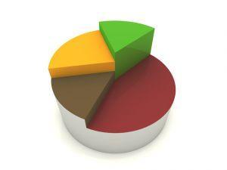
History
First on 16 October 1995.
Little change in definition in 2000.
IE to blame.
A survey showed:
  %61 infected.
  %92 didn’t know about it.
  %91 didn’t give permission.

Slide 11
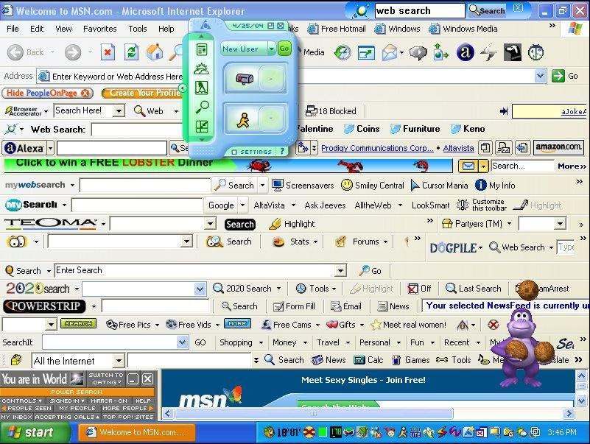
Infection (Intrusion)
Installs itself through deception of the user.
Bundles itself with desirable software.
Using security holes (i.e. Web browser).
Rarely alone, usually multiple infections.
Using Trojan horse.

Slide 12
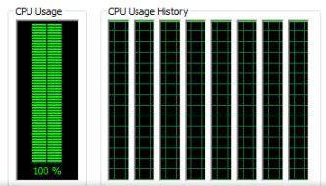
Effects and Comparison
Effects:
  CPU activity, disk usage, network traffic.
  Stability issues, apps freezing, boot failures.
  Hardware issues?
Comparison:
  To Adware and Trackers.
  To viruses and worms.
Examples: (CoolWebSearch, FinFisher, Internet
Optimizer, HuntBar, Movieland, etc.)

Slide 13
Full Disclosure
Andrew Hoch

Slide 14
Full Disclosure
Definition- Full disclosure is where the full details of a security vulnerability are “disclosed” to the public, which includes how to detect and exploit the software.
Theory- The idea for full disclosure is that by releasing the vulnerability to the public that it will result in quicker fixes and better security.

Slide 15
History
This idea of full disclosure first came up in the 19th century for locksmithing. A.C. Hobbs made a statement giving is view on the subject.
This is an ongoing debate that resurfaced in the early 1990s in the software security industry.

Slide 16
Controversy
Against disclosure- Providing complete details to the public allows hackers to take advantage of vulnerabilities a lot easier.
For disclosure- “whitehats” (computer hacker intending to improve security) will obtain the information that has been released to the public and detect and patch.

Slide 17
Google Bombing
David Kahn

Slide 18
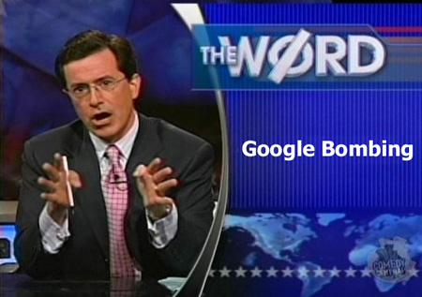

Slide 19
Google Bombing
They’ve been used in political campaigns to associate a negative word or phrase with certain politicians. They’ve even been employed to accompany Internet memes like Chuck Norris. Some Google bombs are still active, despite the fact that Google usually takes measures to remove the forced search results.
Famous ones:
After former senator Rick Santorum made a series of anti-homosexual comments in 2003, sex columnist Dan Savage held an online contest that encouraged his readers to define the term "santorum." He created the website santorum.com, which still houses the sexually explicit definition.

Slide 20
Google Bombing
Considered the first Google bomb in history, a 1999 search for "more evil than Satan himself" turned up search results for Microsoft.
An "I'm feeling lucky" Google search for "find Chuck Norris" yields a fake Google results page, which reads, "Google won't search for Chuck Norris because it knows you don't find Chuck Norris, he finds you."
4.8 million unique visitors in 2008.

Slide 21
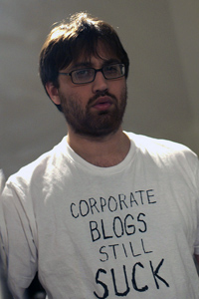
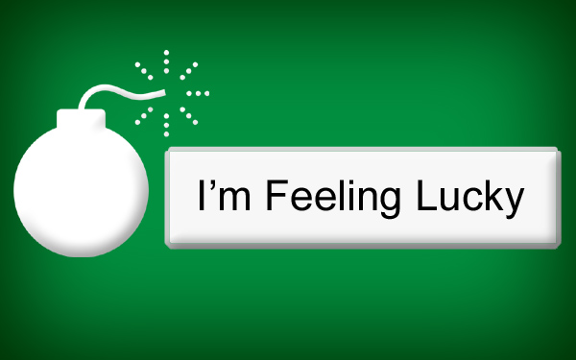
Google Bombing
The technique was first discussed on April 6, 2001 in an article by Adam Mathes. In that article, he coined the term "Google bombing"

Slide 22
Google Bombing
In January of 2007, Google announced that they'd tweaked their search algorithm to remove most Google bombs.
The day they announced this, most searches of previous Google bombs returned empty.

Slide 23
Defensive Programming
Colin Hofman

Slide 24
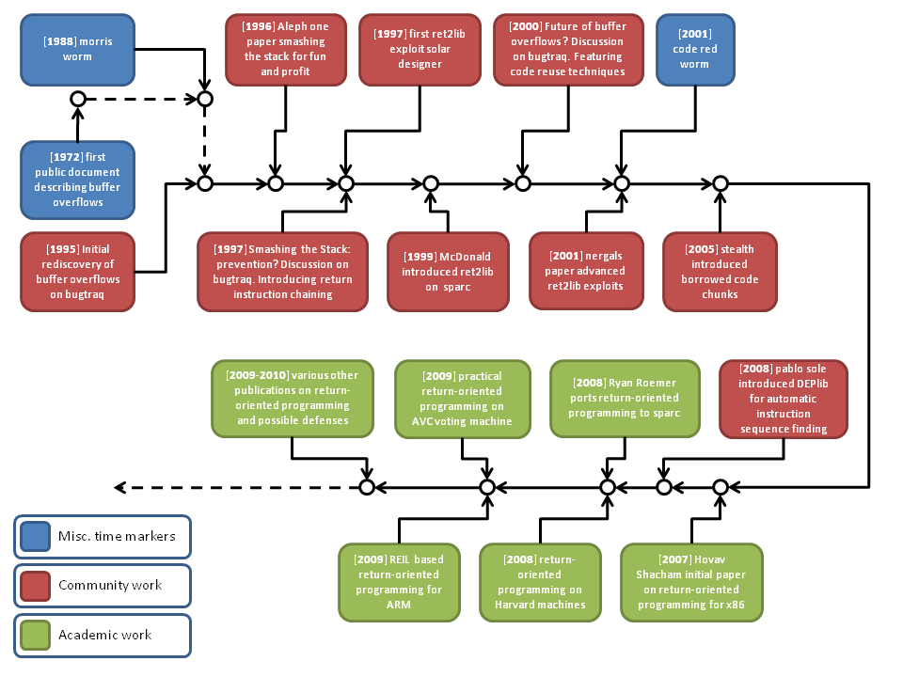
Defensive Programming

Slide 25
What
• Setup a barrier between your program code and the outside world.
• Write code that has the ability to defend itself from being misused.
• If a portion of your code is based on a premise make sure you document and check the precondition prior to execution.

Slide 26
Why
• We cannot always rely on end users to run our code as we intended it to be run.
• Our code might be reused or extended upon by other programmers.
• We can rely on hackers to try to misuse our code, and in extremely innovative ways.
• Throwing exceptions can be very costly.

Slide 27
Guidelines
1.) Assume all user input is bad and write defensively only to the point of data type verification, pattern checks and malicious injection. Defensive programming should be things that can potentially happen very often that you cannot control.
2.) Write exception handling for networked services that may fail at times and handle gracefully for user feedback. Exception programming should be used for networked components that may fail from time to time but are usually solid AND you need to keep your program working.

Slide 28
Guidelines
3.) Don't bother to write defensively within your application after the input data has been validated. It’s a waste of time and bloats your app. Let it blow up because it just means you need to test step 1 and 2 better.
4.) Never write exception handling within your core code that is not dependent on a networked device. Doing so is bad programming and costly to performance. For example catching an out of bounds array. Your code should be tested enough to never do that.

Slide 29
Guidelines
5.) Let everything be handled by central error logging that catches exceptions in one place after following the above procedures. You either screwed up in one of the steps or this is just something in your core environment you could not control and your program should fail.

Slide 30
Cons
• It is important to note that writing defensive code needs to be balanced against other engineering practices.
• Too much defensive code can make the product less readable, less performing, too complex or it may just take too much time to write.
• Don’t let defensive programming turn into paranoid programming.

Slide 31
Worms and Viruses
David Humphries

Slide 32

Virus
•A computer virus is computer program that can replicate itself and spread from one computer to another. In order to replicate itself, a virus must be permitted to execute code and write to memory. For this reason, many viruses attach themselves to executable files. Viruses can be divided into two types based on their behavior when they are executed, resident and nonresident.

Slide 33
Virus
•Nonresident viruses can be roughly divided into two modules.
Finder module-used to locate new executable files to infect
Replicate module- called once the finder module has targeted an executable to be infected
•Resident viruses also have a replicate module but instead of a finder module the virus is loaded into memory and call upon every time the operating system performs a certain operation.
Fast infectors- can infect every potential host file. Can slow down computer performance making it easier to detect.
Slow infectors- designed to infect infrequently to avoid suspicion, but they tend to be not as successful.

Slide 34
Worms
•A computer worm is a standalone computer program that replicates itself in order to spread. The worm usually spreads through a network and typically causes some harm, if only bandwidth consumption. Unlike computer viruses worms do not need to attach themselves to an executable.
•Many worms do not carry a payload that cause changes to the system but rather are only designed only to spread. The few that do carry payloads usually install a backdoor to allow the computer to become a “zombie” for botnets and spam senders.

Slide 35

1971
•“I’m the creeper, catch me if you can!”
•The creeper virus written by Bob Thomas at BBN Technologies was an experimental self-replicating program

Slide 36
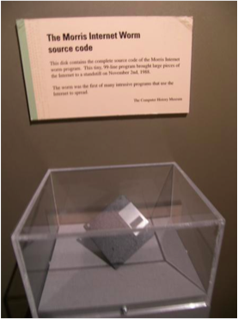
Many More
•Wabbit virus
•Morris worm
•ILOVEYOU worm
•BLASTER worm
•Stuxnet
•Flame
•Many many more

Slide 37
Cyber Web Security
Nina Iarkova

Slide 38
Growing Importance of Web Security
Increased reliance on computers and the vast amount of sensitive information stored on networks
More than 14 billion computers are connected online. Number will soar to 50 billion in next decade (Cisco)
The federal government has suffered a nearly 680% increase in cybersecurity breaches in the past six years
Pentagon declared cyberspace as a “new domain of war”

Slide 39
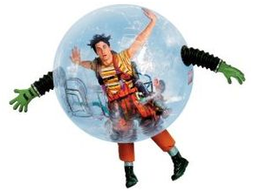
How to Prevent Viruses
Place computer in protective 'bubble'.
  Disconnect Internet or any other networks
  Not use CD-ROMs or any removable disks
  No information will enter
Or...

Slide 40
Cyber Web Security
Use current Anti-Virus software
  Scan every file download before opening it
  Do regular scans
  Keep it updated
Install updates and security patches on all servers, desktops and laptop PCs

Slide 41
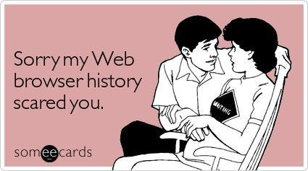
Cyber Web Security
Download files from trusted sources only
If unsure, try downloading to a disk separate from hard drive then scan with antivirus
Ensure website is secure before giving information

Slide 42
Secure Sockets Layer (SSL)
Used for encryption and identification
SSL is a security protocol that provides an encrypted tunnel between your computer and the site you're viewing.
Sites can use SSL to prevent third parties from interfering with the information traveling through the tunnel.

Slide 43
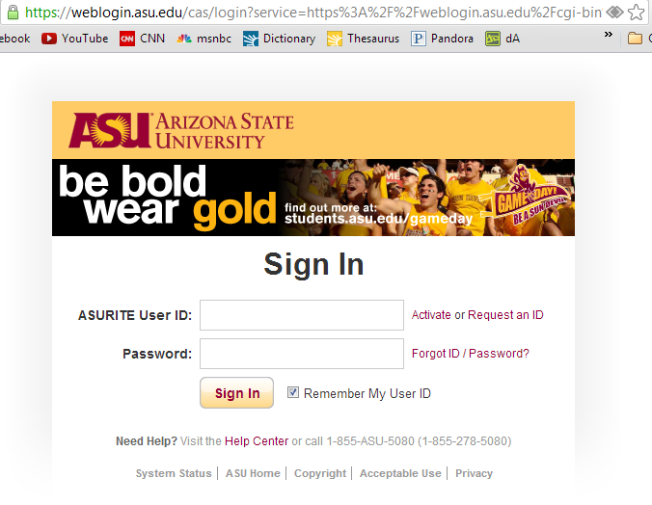
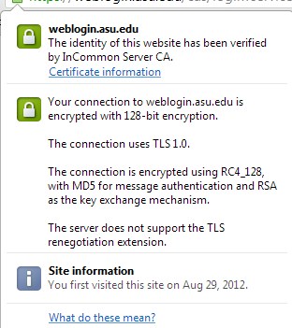
Notes:
Example: will encypt. How do we know? Look at html behind page. Action beings with https: - submits form securely.

Slide 44
SLL: Encryption
The Handshake Process:
Computers agree on how to encrypt with each other.
Server sends certificate about itself and the public key to encrypt. Certificate contains information of who it belongs to.
Client key exchange: both computers calculate a master secret code to encrypt. Then your computer asks server to encrypt.
Server starts encrypting. Sends back to your computer.
All messages are now encrypted. Other computers trying to steal information will see garbage.
Notes:
Before sent, handshake happens.

Slide 45
SLL: Identification
Trust the computer you’re talking to:
Company buys a certificate from a web services company that is a certificate authority (CA), such as VeriSign.
  Has to give load of information such as server, location.
  CA assures identity by going through public records, references, etc.
CA creates certificate and signs it by condensing all details into a number (through hashing). Then encrypts that number with their private key.

Slide 46
SLL: Identification
Certificate given back to the company who installs it in their web server
Your browser is issued with root certificates from Certificate Authorities around the world. Each certificate has public key of that CA.
When browser receives certificate from site, it checks the signature is correct.

Slide 47
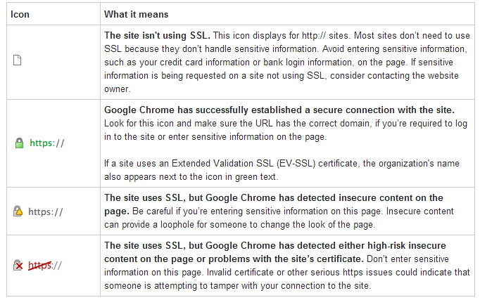

Slide 48
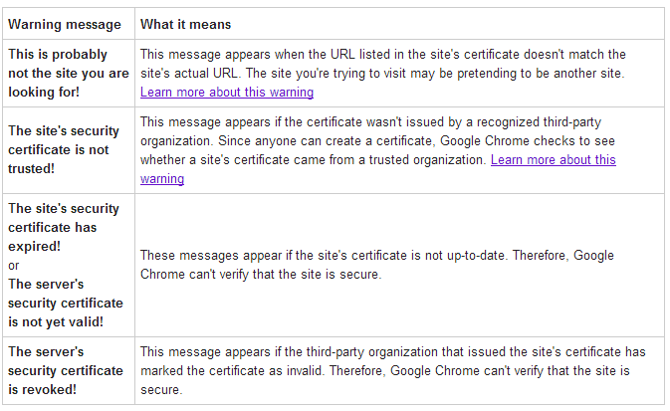

Slide 49
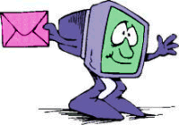
Electronic Privacy
Security: email blockers, filters. Scan content of emails, whitelist, blacklist
Email monitoring – use of content monitoring software that scans for troublesome words that might compromise security. Falls under scope of Fourth Amendment, “reasonable expectation of privacy”

Slide 50
Antivirus
Today, an unprotected computer isn’t just vulnerable, it’s probably already infected
Thousands of new malware, viruses, worms come out each day. How do antivirus vendors keep up?
Can’t. Makes “guesses” on files by behavioral analysis. No antivirus bulletproof
virus definition – database of known viruses

Slide 51
Antivirus
AV-Comparatives releases a summary report on various antivirus products tested each year: http://www.av-comparatives.org
Factors:
  High detection rate of malware, good removal capabilities
  Produce few false positives
  Fast, low system impact
  Protect without relying significantly on user interaction
  No crashes or hangs, no annoying bugs.

Slide 52

Top Antivirus
Kaspersky
Norton
Avast!
BitDefener
Webroot

Slide 53
Smartphone Security
More and more people are using internet on smartphones/tablets
Just like your PC, updates are important
Download apps from trustworthy sites, like App Stores, Google Play. Check reviews and ratings
Find My Phone

Slide 54
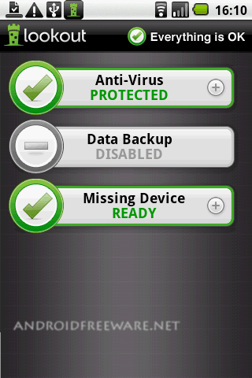
Smartphone Security
Security app like Lookout for iPhone and Android
  Helps avoid risks such as
  connecting to unsecured
  WiFi network
  Clicking fraudulent links
  Postponing updates
  Downloading malicious apps

Slide 55
References
http://www.net-security.org/article.php?id=485
http://www.av-comparatives.org/images/stories/test/summary/summary2011.pdf
http://www.ehow.com/list_6103307_internet-antivirus-security-software.html#ixzz286fRWr00
http://www.ehow.com/list_6103307_internet-antivirus-security-software.html#ixzz286fRWr00
http://www.huffingtonpost.com/2012/08/21/cybersecurity-threats-fact-of-the-day_n_1817671.html
http://www.youtube.com/watch?v=iQsKdtjwtYI&feature=related
http://www.emc.com/collateral/demos/microsites/mediaplayer-video/cybercrime-trends-2012.htm
http://en.wikipedia.org/wiki/Spambot
http://www.scribd.com/doc/14293817/Homeland-Security-A-Technology-Forecast
http://en.wikipedia.org/wiki/Spyware
http://www.bbc.co.uk/news/world-middle-east-11414483
http://www.benedelman.org/news/120704-1.html
http://news.cnet.com/2010-1032-5307831.html
http://www.linksandlaw.com/technicalbackground-google-bombing.htm
http://mashable.com/2012/04/19/google-bombs/
http://www.usnews.com/usnews/culture/articles/000703/archive_015408.htm
http://toonclips.com/600/10953.jpg
http://techrights.org/wp-content/uploads/2008/12/1099212_pie_chart_color_4.jpg
http://www.windows-noob.com/review/ie7/screenshots/xpspyware.jpg
http://onlinesecurityservices.blogspot.com/2008/03/full-disclosure.html
http://en.wikipedia.org/wiki/Computer_virus
http://www.greendaycommunity.org/topic/86705-the-lonely-island/

